Slide 1
BSSE Capstone
Inventory app
Ryan Snell || June 2025 || Class of 2025

Slide 2
Project Management Method Agile
Framework: Scrum.
Sprint Duration: 14 project days (2 weeks).
Ceremonies:
Sprint Planning: Define sprint goals and backlog (2 hours).
Daily Standups: 15-minute sync on progress/blockers.
Sprint Review: Demo features, gather feedback (2 hours).
Sprint Retrospective: Reflect on process improvements (1 hour).

Slide 3
Agile Continued
Artifacts:
Product Backlog: All features/enhancements.
Sprint Backlog: Selected index per sprint.
Increment: Potentially shippable product at sprint end.

Slide 4
Epics
Core Inventory Functionality: CRUD operations, basic UI, API.
Security and Authentication: JWT-based authentication, RBAC.
Advanced Features: Search, offline support, WebSockets, barcode scanning, analytics, internationalization.
Performance and Scalability: Pagination, caching, optimization.
Integrations and Accessibility: IoT integration, accessibility enhancements.
Native Mobile Transition and CI/CD: Swift iOS, Kotlin Android, automated testing/deployment.

Slide 5
Sprint 1 (Day 1–14): Core Backend and Database
Goal: Set up Express.js API and MongoDB schema.
Stories: 1.5 (MongoDB schema, 2 points), 1.1 (Add Item API, 5 points, partial), 1.2 (View Items API, 3 points, partial)
Tasks:
Task 1: Implement Item schema (2 points, 16 hours, Backend)
Define schema with Mongoose (8 hours).
Add text/sparse indexes (4 hours).
Write Jest unit tests (4 hours).
Task 2: Create POST /api/server endpoint (2 points, 16 hours, Backend)
Implement route handler (6 hours).
Add input validation (4 hours).
Write Supertest integration tests (6 hours).

Slide 6
Sprint 1 (Day 1–14): Core Backend and Database Continued
Task 3: Create GET /api/server endpoint (1 point, 8 hours, Backend)
Implement route handler (4 hours).
Write integration tests (4 hours).
Total Points: 5
Total Hours: 40 (Backend: 40, QA: 4 for concurrent test review)
Deliverable: Functional backend API for adding/viewing index.
Assigned Roles: Backend (2), QA (1)

Slide 7
Sprint 2 (Day 15–28): Web Frontend (Vue.js) Core
Goal: Build Vue.js frontend for core CRUD.
Stories: 1.1 (Add Item UI, 5 points, partial), 1.2 (View Items UI, 3 points), 1.3 (Edit Item UI, 5 points, partial), 1.4 (Delete Item UI, 3 points)
Tasks:
Task 1: Create HomePage.vue and ItemList.vue (2 points, 16 hours, Frontend)
Set up Vue Router and HomePage.vue (6 hours).
Implement ItemViewModal.vue custom PostCSS (6 hours).
Write Vitest unit tests (4 hours).
Task 2: Implement AddItemModal.vue (2 points, 16 hours, Frontend)
Create modal with form using custom PostCSS styles instead of TailwindCSS (6 hours).
Integrate POST /api/server via Axios (6 hours).
Write Cypress E2E tests (4 hours).

Slide 8
Sprint 2 (Day 15–28): Web Frontend (Vue.js) Core Continued
Task 3: Implement EditItemModal.vue (2 points, 16 hours, Frontend)
Create modal with pre-filled form using custom PostCSS styles instead of TailwindCSS (6 hours).
Integrate GET/PUT /api/server/:id (6 hours).
Write E2E tests (4 hours).
Task 4: Add delete functionality (1 point, 8 hours, Frontend)
Add delete button with prompt (4 hours).
Integrate DELETE /api/server/:id (4 hours).
Total Points: 7
Total Hours: 56 (Frontend: 56, QA: 8 for concurrent test review)
Deliverable: Web app with basic CRUD.
Assigned Roles: Frontend (2), QA (1)
Dependencies: Sprint 1 (backend API)

Slide 9

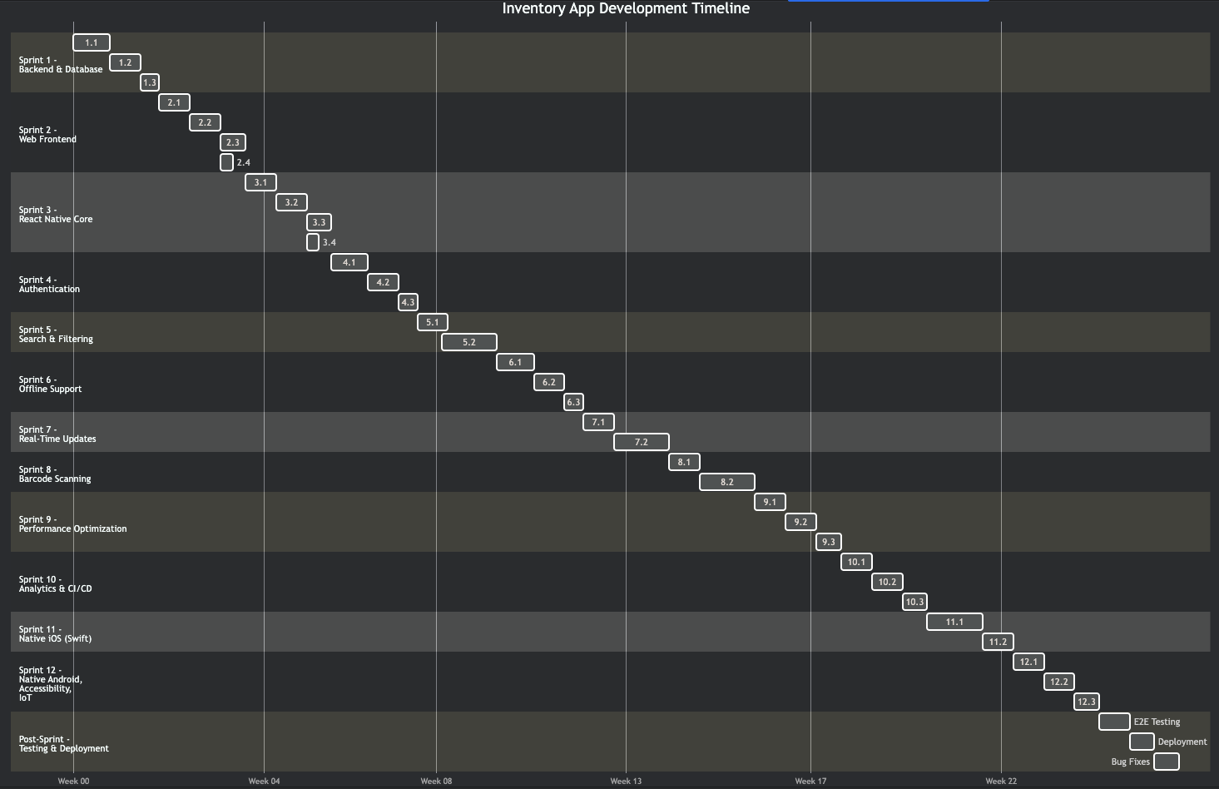



Gantt Chart

Slide 10
Additional Sprints
Sprint 3 (Day 29–42): React Native Mobile Core
Sprint 4 (Day 43–56): Authentication
Sprint 5 (Day 57–70): Search and Filtering
Sprint 6 (Day 71–84): Offline Support
Sprint 7 (Day 85–98): Real-Time Updates
Sprint 8 (Day 99–112): Barcode Scanning
Sprint 9 (Day 113–126): Performance Optimization
Sprint 10 (Day 127–140): Analytics and CI/CD
Sprint 11 (Day 141–154): Native Mobile (Swift iOS)
Sprint 12 (Day 155–168): Native Mobile (Kotlin Android), Accessibility, IoT
Post-Sprint (Day 169–181): Final Testing and Deployment

Slide 11
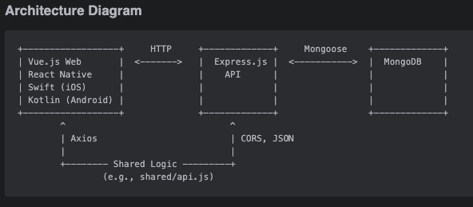

Slide 12
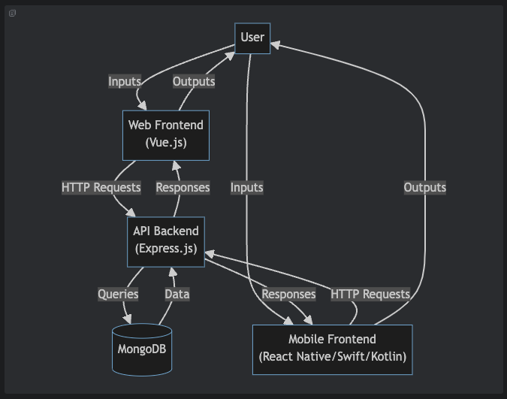
Data Flow Diagram Continued

Slide 13
Questions???

